Slide 1
Gated Graphs and Causal Inference
John Winn
Microsoft Research, Cambridge
with lots of input from Tom Minka
Networks: Processes and Causality, September 2012

Slide 2
Outline
Graphical models of mixtures
Gated graphs
d-separation in gated graphs
Inference in gated graphs
Modelling interventions with gated graphs
Causal inference with gated graphs

Slide 3


A mixture of two Gaussians
$P\left(X\right)=P\left(C=1\right)N\left(X | μ_{1},σ_{1}^{2}\right)+$ $P\left(C=2\right)N\left(X | μ_{2},σ_{2}^{2}\right)$
$$P\left(X\right)$$
C=2
C=1
$$X$$

Slide 4
Mixture as a Bayesian Network
$P\left(X|C,μ_{1},μ_{2},σ_{1},σ_{2}\right)=δ\left(C=1\right)N\left(X | μ_{1},σ_{1}^{2}\right)+$ $δ\left(C=2\right)N\left(X | μ_{2},σ_{2}^{2}\right)$
All structure is lost!

Slide 5
Mixture as a Factor Graph
$$P\left(X|C,μ_{1},μ_{2},σ_{1},σ_{2}\right)={N\left(X | μ_{1},σ_{1}^{2}\right)}^{δ(C=1)}{N\left(X | μ_{2},σ_{2}^{2}\right)}^{δ(C=2)}$$
Context-specific independence is lost!

Slide 6
Mixture as a Gated Graph
$$P\left(X|C,μ_{1},μ_{2},σ_{1},σ_{2}\right)={N\left(X | μ_{1},σ_{1}^{2}\right)}^{δ(C=1)}{N\left(X | μ_{2},σ_{2}^{2}\right)}^{δ(C=2)}$$
Context-specific independence is retained!

Slide 7
gated graphs

Slide 8
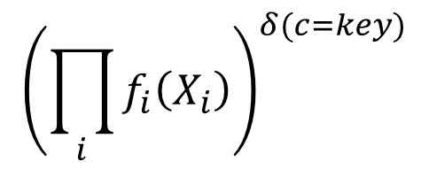
The Gate
Gate
Selector variable
Key
Key
$${\left(\prod_{i}{f_{i}\left(X_{i}\right)}\right)}^{δ(c=key)}$$
Gate:
Selector variable
Contained factor(s)
Contained factor(s)
[Minka & Winn, Gates. NIPS 2009]

Slide 9
Mixture of Gaussians
$$P\left(X|C\right)={N\left(X | μ_{1},σ_{1}^{2}\right)}^{δ(C=1)}{N\left(X | μ_{2},σ_{2}^{2}\right)}^{δ(C=2)}$$
Gate block

Slide 10
Mixture of Gaussians
$$P\left(X|C\right)={N\left(X | μ_{1},σ_{1}^{2}\right)}^{δ(C=1)}{N\left(X | μ_{2},σ_{2}^{2}\right)}^{δ(C=2)}$$
Gate block

Slide 11
Mixture of Gaussians
$$P\left(X|C\right)={N\left(X | μ_{1},σ_{1}^{2}\right)}^{δ(C=1)}{N\left(X | μ_{2},σ_{2}^{2}\right)}^{δ(C=2)}$$
Gate block

Slide 12
Model Selection
Model 1
Model 2

Slide 13
Model Selection
Model 1
Model 2

Slide 14
Structure learning
Edge presence/absence
Variable presence/absence
Edge type

Slide 15
Example: image edge model

Slide 16
Example: genetic association study

Slide 17
D-separation in gated graphs

Slide 18
d-separation in factor graphs
Tests whether X independent of Y given Z.
Criterion 1:
Observed node on path
Criterion 2:
No observed descendant

Slide 19











d-separation with gates
Gate selector acts like another parent
$$X$$
$$X$$
$$X$$
$$X$$
F
F
F
F
$$Z$$
$$W$$
$$W$$
$$Z$$
Y
$$W$$
Y
$$W$$
T
T
T
T
Y
Y
$$Z$$
Criterion 1:
Observed node on path
Criterion 2:
No observed descendant

Slide 20






d-separation with gates
Paths are blocked by gates that are off,
but pass through gates that are on.
$Z$=T
$Z$=F
F
F
$$Y$$
$$X$$
$$Y$$
$$X$$
T
T
Criterion 3 (context-sensitive):
Path passes through off gate

Slide 21
d-separation summary
Criterion 1: Observed node on path
Criterion 2: No observed descendant
Criterion 3: Path passes through off gate
New!
Allows new independencies to be detected,
(even if they apply only in particular contexts)

Slide 22
Inference in gated graphs

Slide 23
Inference in Gated Graphs
Extended forms of standard algorithms:
belief propagation
expectation propagation
variational message passing
Gibbs sampling
Algorithms become more accurate + more efficient by exploiting conditional independencies.
Free software at http://research.microsoft.com/infernet
[Minka & Winn, Gates. NIPS 2009]

Slide 24
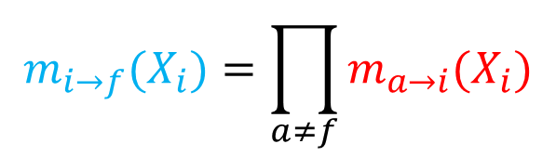
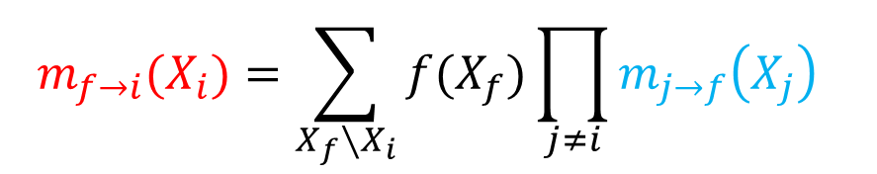
BP in factor graphs
$$m_{i→f}(X_{i})=\prod_{a≠f}{m_{a→i}(X_{i})}$$
Variable to factor
$$m_{f→i}(X_{i})=\sum_{X_{f}∖X_{i}}{f(X_{f})\prod_{j≠i}{m_{j→f}\left(X_{j}\right)} }$$
Factor to variable

Slide 25



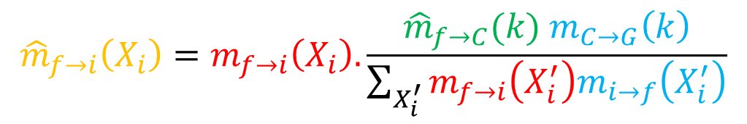
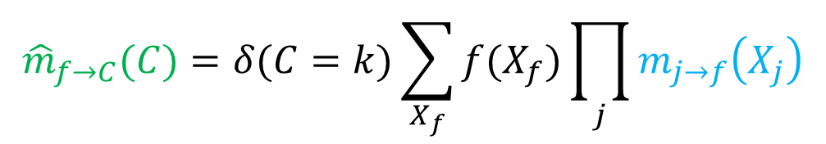
BP in a gate block
$$∑$$
$${ m}_{C→G}$$
$$∑$$
$${\hat{m}}_{f→C}(C)=δ(C=k)\sum_{X_{f}}{f(X_{f})\prod_{j}{m_{j→f}\left(X_{j}\right)}}$$
Factor f_{k} to selector
(evidence)
$${\hat{m}}_{f→i}\left(X_{i}\right)=m_{f→i}\left(X_{i}\right).\frac{{\hat{m}}_{f→C}(k){ m}_{C→G}\left(k\right)}{\sum_{X_{i}^{′}}{m_{f→i}\left(X_{i}^{′}\right)m_{i→f}\left(X_{i}^{′}\right)}}$$
Factor f_{k} to variable
(after leaving gate)
scale factor

Slide 26
Modelling Interventions with gated graphs
(yes – I’m finally getting round to talking about causality)

Slide 27
Intervention with Gates
doZ
False
Y
Z
f
True
Gate block
I

Slide 28
Normal (no intervention)
doZ
=
F
F
Y
Z
f
T
I

Slide 29
Intervention on Z
doZ
=
T
F
Y
Z
f
T
I

Slide 30
Example model

Slide 31
Example model with interventions

Slide 32
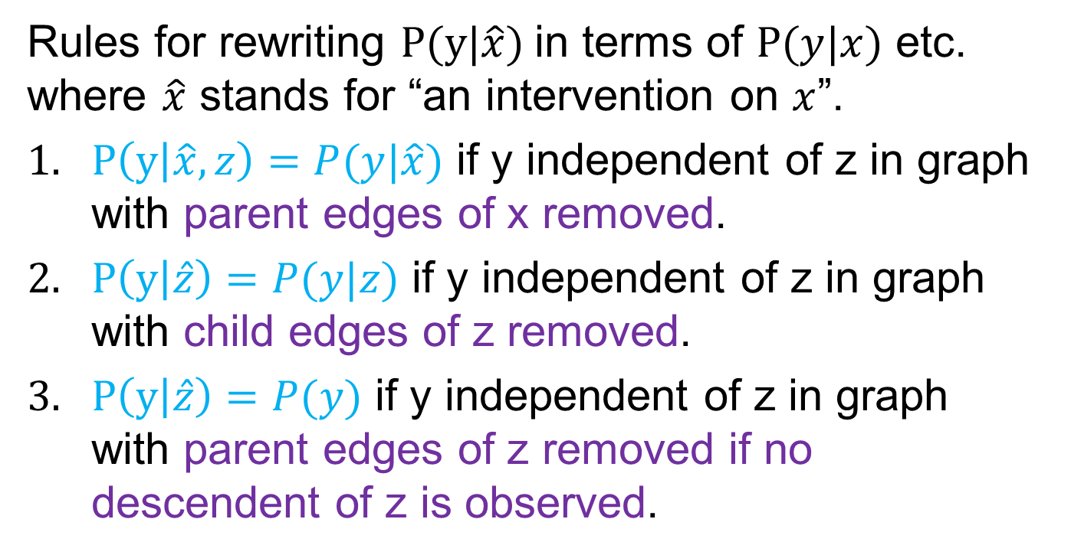
do calculus
Rules for rewriting $P(y|\hat{x})$in terms of $P(y|x)$ etc. where $\hat{x}$ stands for “an intervention on $x$”.
$P\left(y | \hat{x},z\right)=P(y|\hat{x})$ if y independent of z in graph with parent edges of x removed.
$P\left(y | \hat{z}\right)=P(y|z)$ if y independent of z in graph with child edges of z removed.
$P\left(y | \hat{z}\right)=P(y)$ if y independent of z in graph with parent edges of z removed if no descendent of z is observed.
[Pearl, Causal diagrams for empirical research, Biometrika 1995]

Slide 33









Rule 1: deletion of observations
do calculus
gates
$P\left(y | \hat{x},z\right)=P(y|\hat{x})$
$P(y│doX=T,z)=P(y|doX=T)$
$doX$=T
parents($x$)
$$\hat{x}$$
Criterion 3:
Gate is off
F
Remove parent edges of x
parents($x$)
$$x$$
T
parents($x$)
$$x$$

Slide 34










Rule 2: action/observation exchange
do calculus
gates
$$P\left(y | \hat{z}\right)=P(y|z)$$
$$P(y│doZ=T,z)=P(y|doZ=F,z)$$
Criterion 1:
Observed node on path
$$doZ$$
$$\hat{z}$$
children($z$)
F
Remove child edges of z
parents($z$)
$$z$$
T
$$z$$
children($z$)
children($z$)

Slide 35











Rule 3: deletion of actions
do calculus
gates
$$P\left(y | \hat{z}\right)=P(y)$$
$$P(y│doZ)=P(y)$$
Criterion 2:
No observed descendent
parents($z$)
$$\hat{z}$$
$$doZ$$
F
parents($z$)
$$z$$
parents($z$)
$$z$$
T
desc($z$)
desc($z$)

Slide 36



Rule 3: deletion of actions
do calculus
gates
$$P\left(y | \hat{z}\right)=P(y)$$
$$P(y│doZ)=P(y)$$
parents($z$)
$$\hat{z}$$
$$doZ$$
F
parents($z$)
$$z$$
parents($z$)
$$z$$
T
desc($z$)
desc($z$)

Slide 37
do calculus equivalence
The three rules of do calculus
are a special case of
the three d-separation criteria
applied to the gated graph of an intervention.

Slide 38
Causal inference with gated graphs

Slide 39
Causal Inference using BP

Slide 40
Causal Inference using BP
Intervention on X
Posterior for Y

Slide 41
Causal Inference using BP
Posterior for Y
Intervention on Z

Slide 42
Learning causal structure
Does A cause B or B cause A?
A, B are binary.
f is noisy equality with flip probability q.

Slide 43
Learning causal structure
Add gated structure for intervention on B

Slide 44
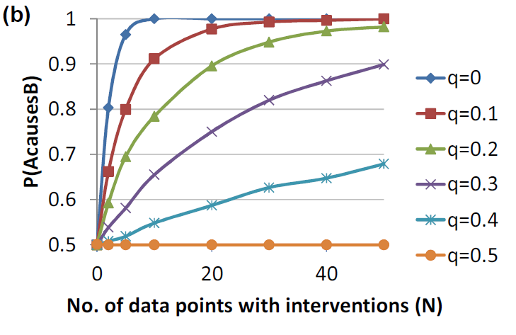
Learning causal structure

Slide 45
…and without interventions
Y
1
g(r)
1-r
X
0
r
1
Thanks to Bernhard!

Slide 46
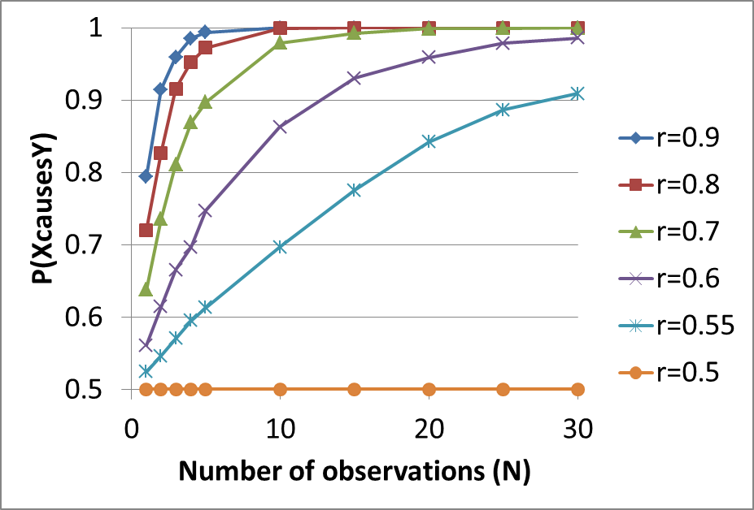
…and without interventions
Same algorithm as before

Slide 47
Dominik’s idea

Slide 48
Conclusions
Causal reasoning is a special case of probabilistic inference:
The rules of do-calculus arise from testing
d-separation in the gated graph.
Causal inference can be performed using probabilistic inference in the gated graph.
Causal structure can be discovered by using gates in two ways:
  to model interventions and/or
  to compare alternative structures.

Slide 49
Future directions
Imperfect interventions
  Partial compliance
  Mechanism change
Counterfactuals
  Variables that differ in the real and counterfactual worlds lie in different gates
  Variables common to both worlds lie outside the gates

Slide 50
Thank you!

Slide 51
Imperfect Interventions
‘Fat hand’
Mechanism change
Partial compliance

